Slide 1

Twitter Spoilers
A Big Data Guide to Finding and Avoiding
Undesired Media Content
Mengting Ding, Jacob Haney, Dylan Koury, and Olivia Siegal
Team 5

Slide 2
Outline
Spoilers: What are they?
Business Problem
Spoilers: Where to Find Them
Hypotheses
Data Preparation
Data Analysis
Spoilers: How to Avoid Them
Current Filtering Options
Introducing Twitter: Spoiler Alert

Slide 3
Spoilers: What are They?
Definition
Information regarding important plot developments in popular media which if previously known may reduce surprise/suspense for first-time viewers
Problem
Consumers will often avoid internet and social media to stay spoiler-free
Opportunity
Keep Twitter users worried about spoilers connected online by automatically filtering out spoiler content from their feed

Slide 4
Spoilers: Where to Find Them
Tweets
Retweets
Images and Links
Poster may not always provide spoiler warning
Popular discourse tweets are more likely to show up on a user’s feed
The “comments” of Twitter
Usually contain further discussion that may naturally dive into spoiler territory
Can be combatted with “comment restrictions” by original poster
Commonly used by “internet trolls”
Images in tweets are likely to contain photos or videos from popular media that may depict a “spoiler” scene such as a cameo or a character death
Notes:
Maybe split this slide up or add more in depth slides later with examples

Slide 5








Our Process
Neural Network Prediction Algorithm
Data Labeling
Labeled
Data Streaming
Unlabeled
Data Analysis
Data Visualization
Unlabeled
Aggregated

Slide 6
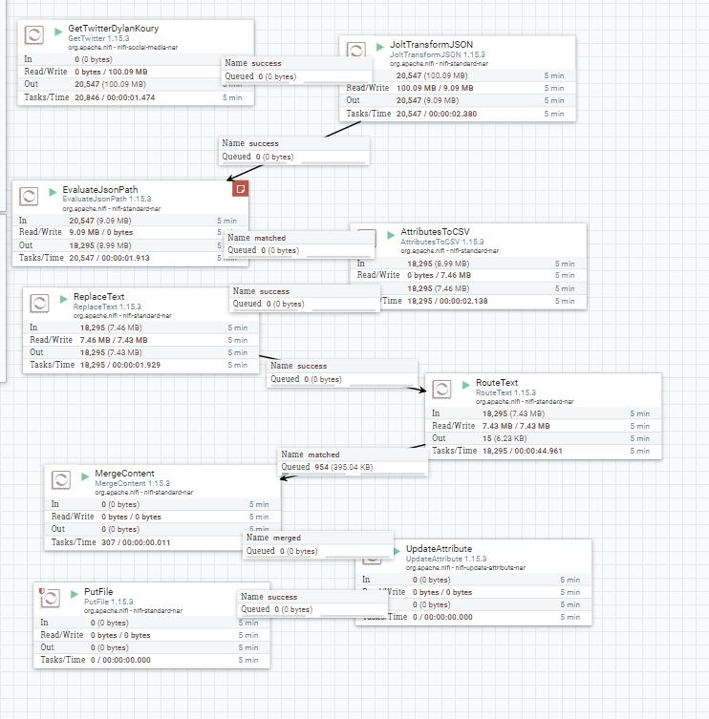
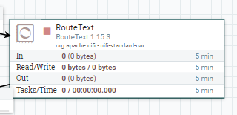
Nifi
Data Stream Issues
Data Stream Solution
A lot of data per second
Storage fills up quickly
Filter output by text
Storage fills up slowly
Notes:
Ignoring case and whitespace to make regex use less complicated
.* on either side as the word could be anywhere in the text with any characters on either side
Will filter on tweets that contain any of these words

Slide 7
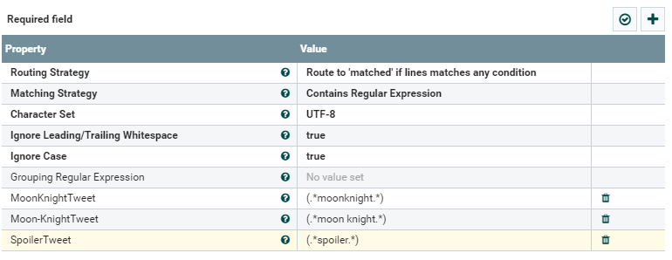
Nifi
Filtering on keywords significantly reduces data storage to only desired tweets
Notes:
Ignoring case and whitespace to make regex use less complicated
.* on either side as the word could be anywhere in the text with any characters on either side
Will filter on tweets that contain any of these words

Slide 8
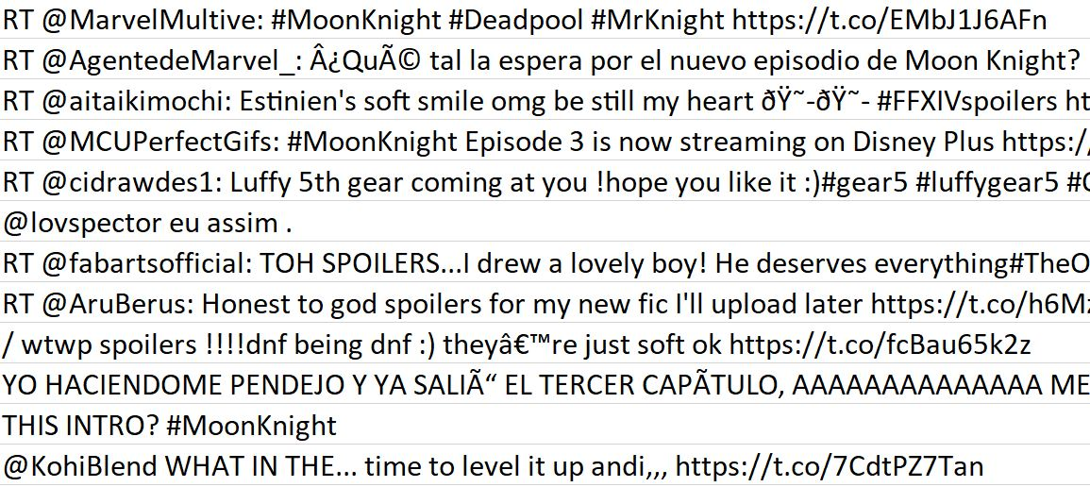
MapReduce
Unclean Data Issues
ISSUE
1
Unnecessary punctuation

Slide 9
MapReduce
Unclean Data Issues
ISSUE
2
Undesired Filler Words

Slide 10
MapReduce
Unclean Data Issues
ISSUE
3
Unique Links Treated Distinctly

Slide 11
MapReduce
Unclean Data Issues
Case Differences Treated Distinctly
ISSUE
4

Slide 12
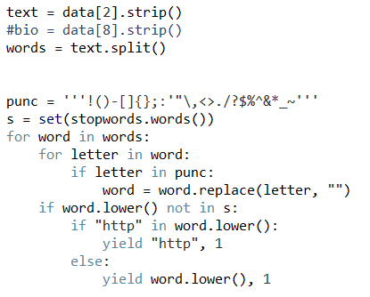
MapReduce
Pre-Processing Steps
Split tweet text into words
Remove undesired punctuation
(Keeping @ and #)
Keep non-stopwords
Generalize links as “http”
Lowercase output for standardization

Slide 13
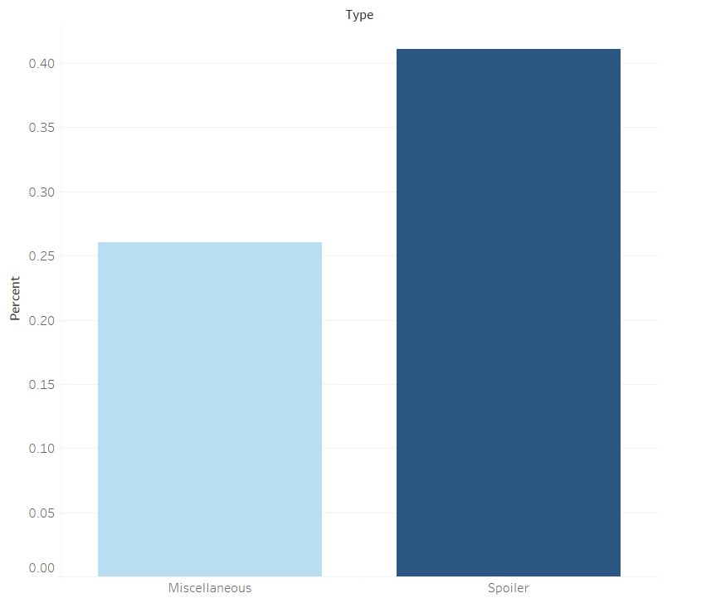
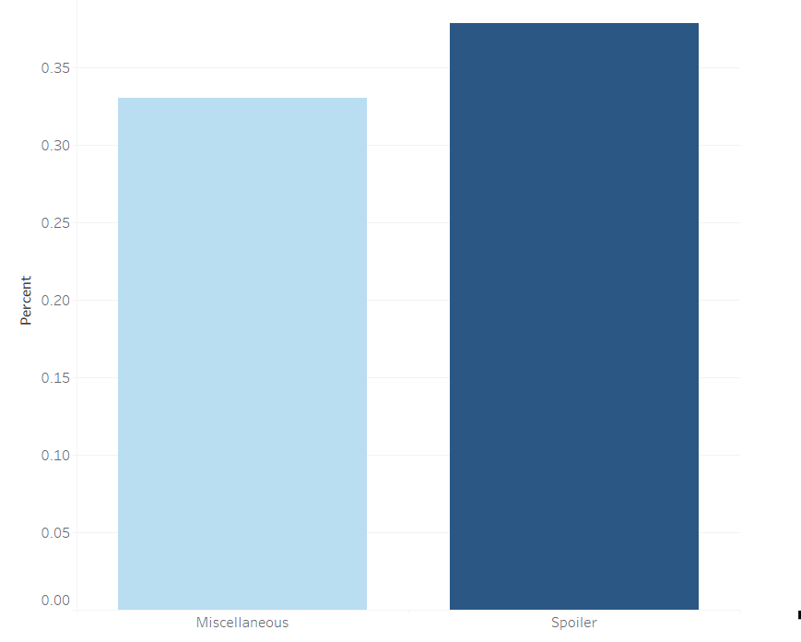
What does the data say?
Retweets
Containing Image/Link
Percent
Percent
Miscellaneous Spoiler
Miscellaneous Spoiler
The data supports our hypotheses
Notes:
Im thinking

Slide 14
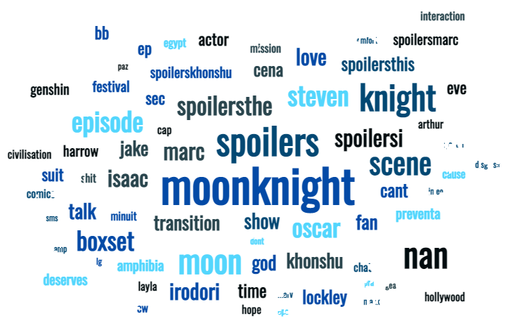

Top “Spoiler” Words Examples
Moon Knight
Fantastic Beasts:
The Secrets of Dumbledore
The newest Marvel TV show
The latest Harry Potter movie
Notes:
Someone suggested to me we can do a word cloud (words with higher counts are bigger)

Slide 15
Spoilers: How to Avoid Them
Manual
Automatic
Muting Tweets
Advanced Search
Neural Network Classification Filter
2
Currently Available on Twitter
Not Available on Twitter

Slide 16

Manual Filtering: Muting Tweets
CONS:
One word at a time
Only filters notifications and timeline
MANUAL
PROS:
Easy to use
Versatile
Can set time limit

Slide 17
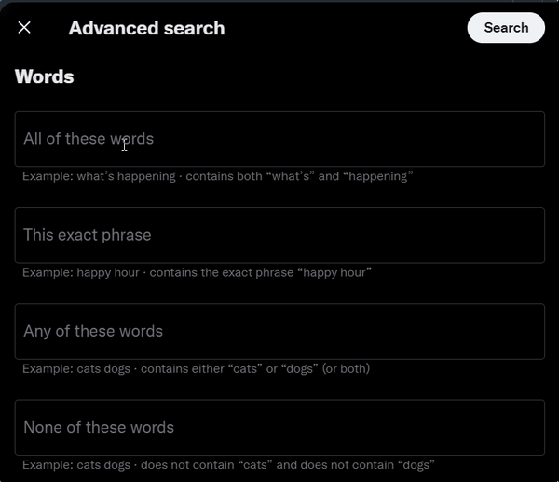
Manual Filtering: Advanced Search
CONS:
Must already search before option available
One time use
MANUAL
PROS:
Easy to use
Versatile

Slide 18
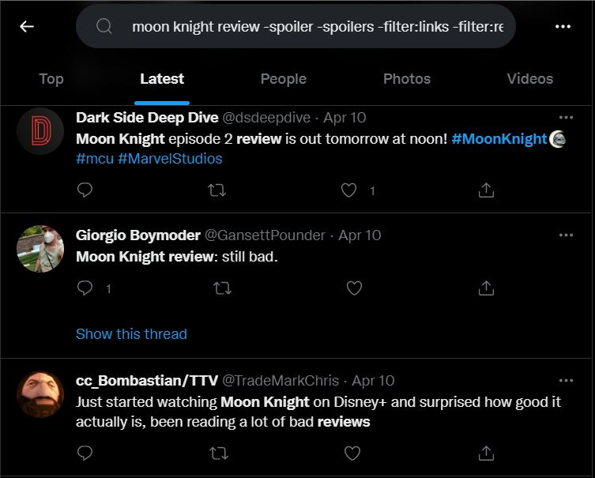
Advanced Search Output

Slide 19
Going Forward: Automatic Spoiler Filtering
Predictive modeling to automatically flag tweets as potentially containing spoiler content
Process Steps
Semi-Manually Label Tweets
“1” for “spoiler”
“0” for “non-spoiler”
Train and test neural network for accuracy
Test once more with new data
Implement model into Twitter infrastructure
DISCLAIMER: The following is just a demonstration of a much more extensive process

Slide 20
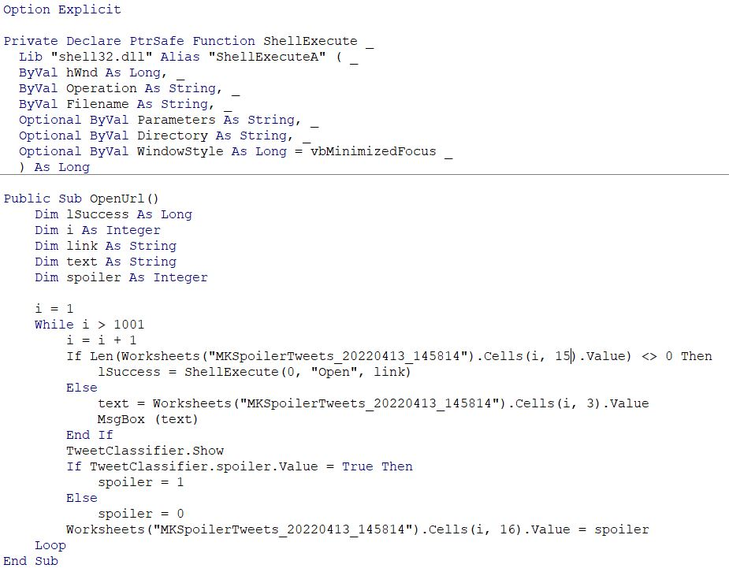
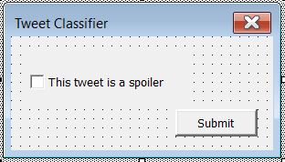
VBA: Spoiler Labeling
Tweets with an image link will open it
Tweets without will display tweet text
The user will complete this prompt
The label will be automatically updated
Notes:
Only used 1000 tweets

Slide 21
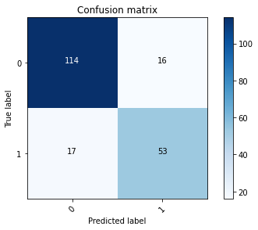
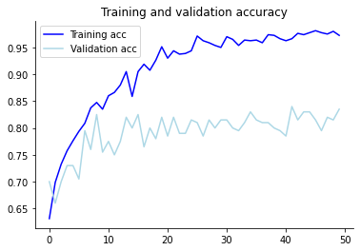
Neural Network: Training and Testing
This Recurrent Classifier Model averaged about an 80% accuracy on the test set

Slide 22
Neural Network: Spoiler Predicting
Insert here how the Fantastic Beasts data performed in the model
Notes:
Likely more work to be done

Slide 23
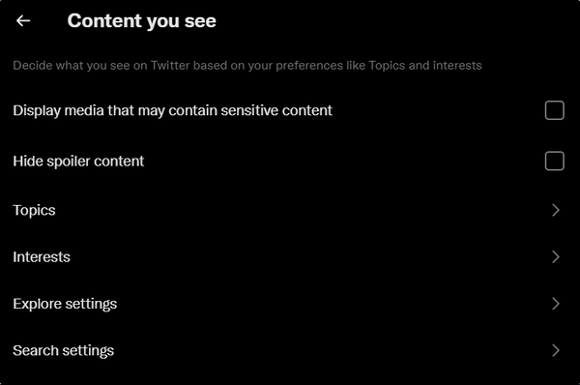
Twitter: Spoiler Alert
PROS:
Easy to use
AUTOMATIC
CONS:
Doesn’t exist yet
DISCLAIMER: NOT a current feature of Twitter

Slide 24
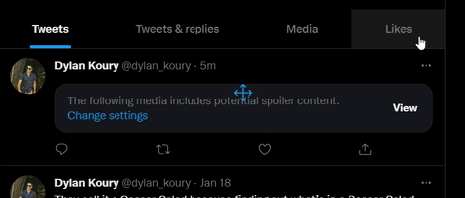
Twitter: Spoiler Alert
DISCLAIMER: NOT a current feature of Twitter

